Slide 1
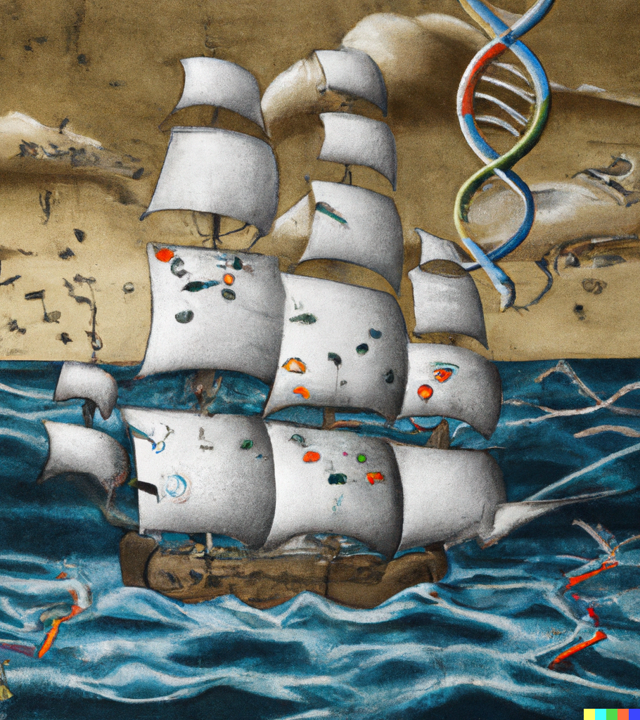
Exploratory Data Analysis
Discuss basics of multivariate statistical analysis
Carry out hierarchical clustering of samples
Discuss and perform principal component analyses
Produce ‘small multiples’ plot
Use standard dplyr ‘verbs’ to query our data
Produce interactive graphics using plotly
Produce interactive tables with DT package

Slide 2
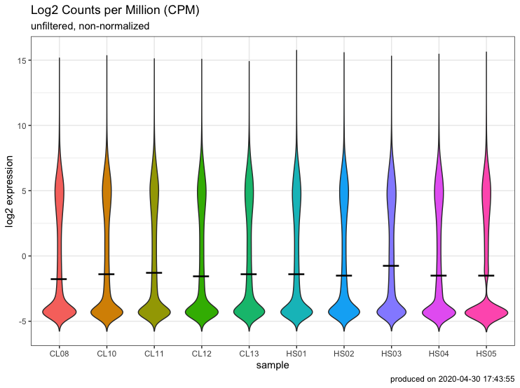
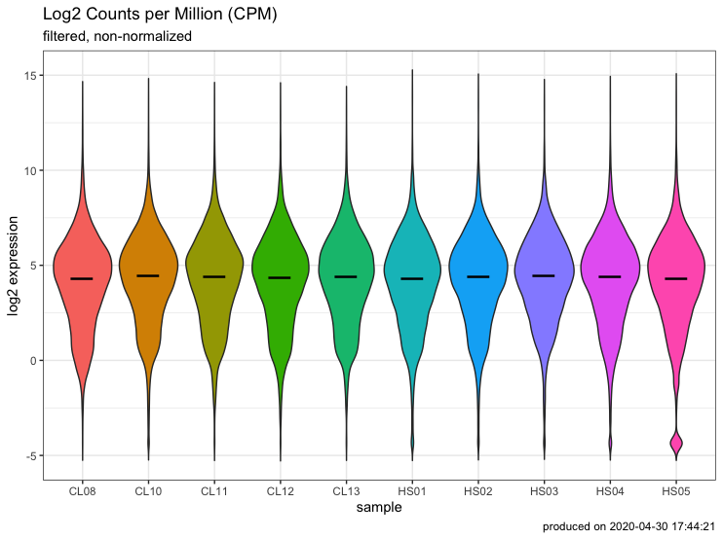
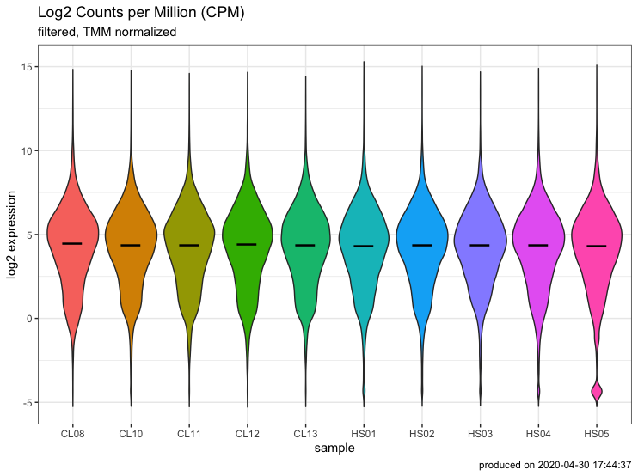
What we accomplished in the last lecture
Raw
Filtered
Normalized
Base R
rowSums()
edgeR::
calcnormfactors
as_tibble()
as_tibble()
as_tibble()
pivot_longer()
pivot_longer()
pivot_longer()
ggplot()
ggplot()
ggplot()

Slide 3




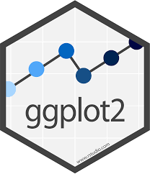





The Tidyverse
rename()
select()
as_tibble()
ggplot()
read_tsv()
pivot_longer()
Tidyverse packages/functions only work with data frames
The readr package always produces a data frame
A tibble is still a data frame, but with nicer display and subsetting
‘Piping’ with %>% (magrittr package) makes code more succinct and readable
Once you grasp the layered approach of ggplot, easy to connect with other R packages (e.g., Plotly and gt)

Slide 4

Understanding sources of variation

Slide 5
When it comes to potential sources of variance, not all experiments are created equal
highest
variability
lowest
variability
Cultured cell line
Cultured 1 cell
Mouse
expr.
Mouse
behavior
Human clinical
Human behavior
The type of experiment will influence your sources of variance and the types of metadata you need to consider

Slide 6
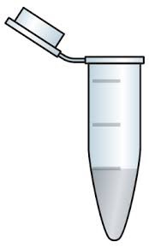
Potential sources of variation
variable of interest
wt
wt
wt
wt
ko
ko
ko
ko
sex | ♂ | ♂ | ♀ | ♂ | ♀ | ♀ | ♂ | ♂
batch | 1 | 1 | 1 | 1 | 1 | 1 | 2 | 2
batch | 1 | 2 | 3 | 4 | 1 | 2 | 3 | 4
run | 1 | 1 | 1 | 1 | 1 | 1 | 1 | 1
person | 1 | 2 | 1 | 1 | 1 | 2 | 1 | 1
x | 1 | 1 | 1 | 1 | 2 | 2 | 2 | 2
confounding variables
‘Metadata’ = data about your data

Slide 7
How do we visualize variance in our data?
If a variable is not recorded
….you can’t!

Slide 8
How do we visualize variance in our data?

Slide 9
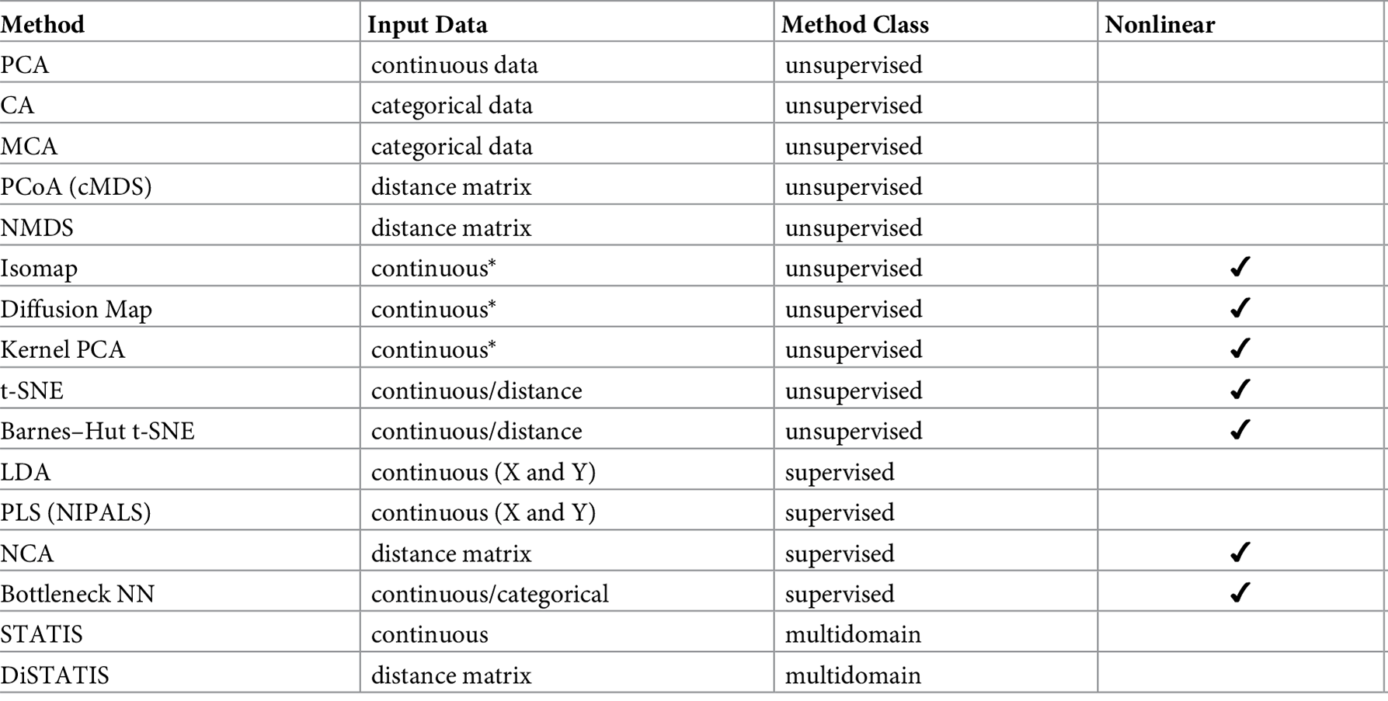
Many options for dimensional reduction
Nguyen and Holmes, PLOS Comp Bio, 2019

Slide 10
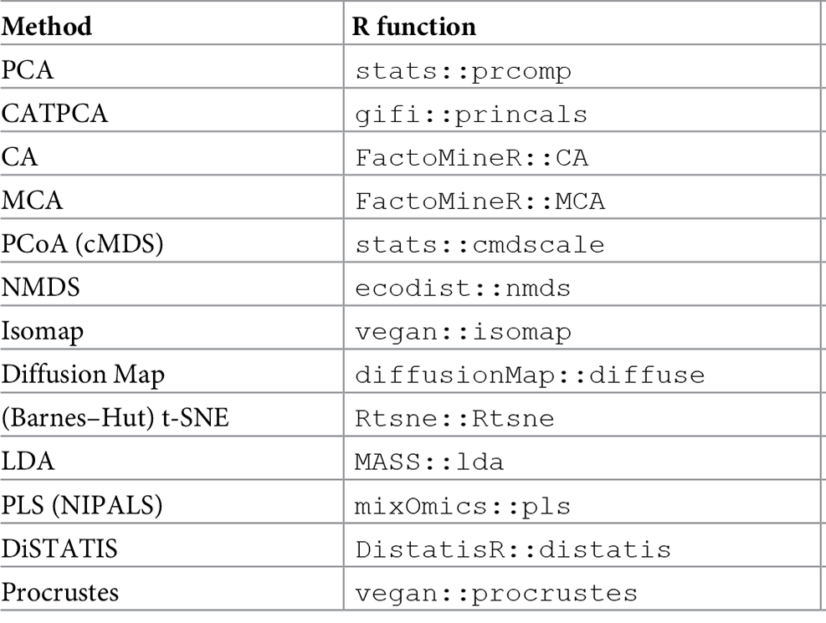
Many options for dimensional reduction
Nguyen and Holmes, PLOS Comp Bio, 2019

Slide 11
Understanding PCA
 | Person 1 | … | Person n
Height | 72 | 60 | 75
Weight | 150 | 190 | 130
See statQuest
video for math
2D
 | Person 1 | … | Person n
Gene A | 72 | 60 | 75
Gene B | 150 | 190 | 130
Gene C | 72 | 60 | 75
Gene D | 150 | 190 | 130
Gene E | 72 | 60 | 75
Gene F | 150 | 190 | 130
Gene G | 72 | 60 | 75
… | 150 | 190 | 130
Gene n | 72 | 60 | 75
PC2
Weight
(shape)
PC1
(size)
Multi-D
Is a PC just an abstract concept, or can I relate it to something ‘real’?
Height

Slide 12
Run our PCA and plot the results
step 3 script

Slide 13
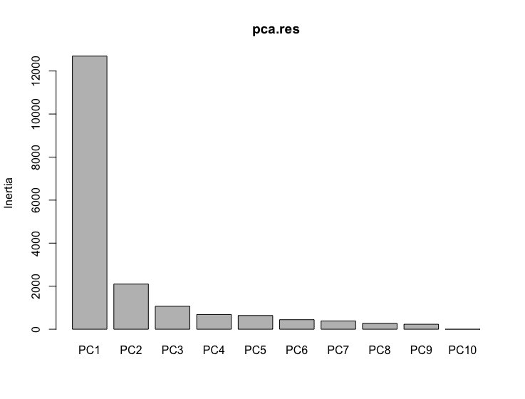
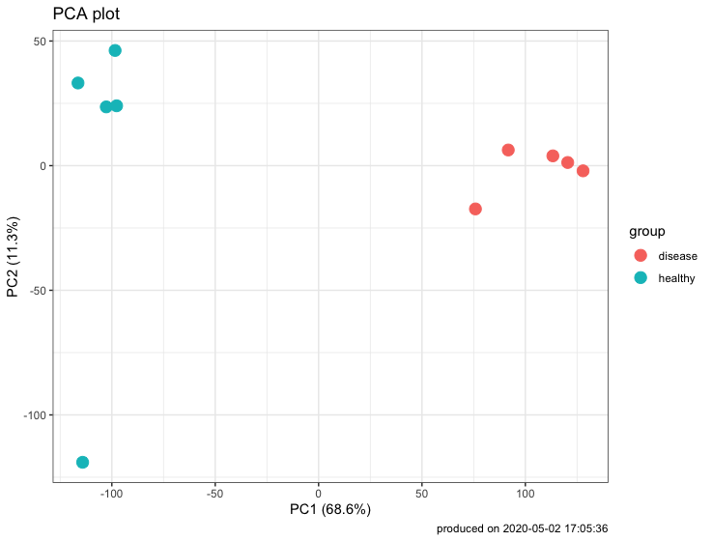



What if it’s not so simple?
PC1 explains most of the variance
Disease status is easily identified as PC1 while an outlier accounts for PC2
You have many covariates to explore and substantial variation explained by multiple PCs

Slide 14
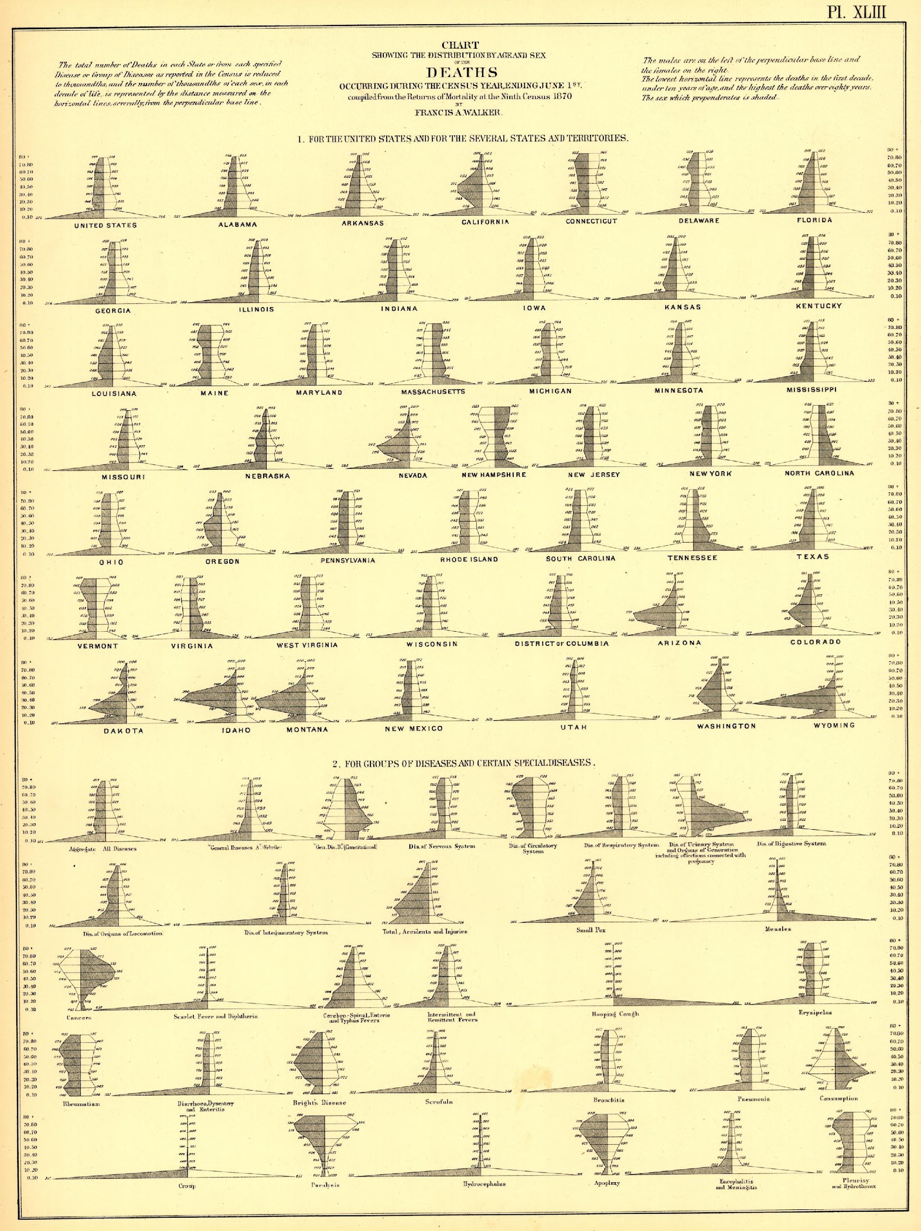
‘Small multiples’ plot
Similar graphs using the same axes and labels
PC1
PC2
PC3
PC4
PC5
PC6
PC7

Slide 15
small multiples make it easy to spot interesting combinations of variables

Slide 16
back to script

Slide 17
Take the time to thoroughly explore your data before downstream analyses

Slide 18
Using %>% to streamline your code
my_new_object <- doSomething(my_data)
my_new2_object <- doSomething_else(my_new_object)
my_new3_object <- doSomething_different(my_new2_object)
Magrittr package
my_new_object <- my_data %>%
doSomething() %>%
doSomething_else() %>%
doSomething_different()

Slide 19
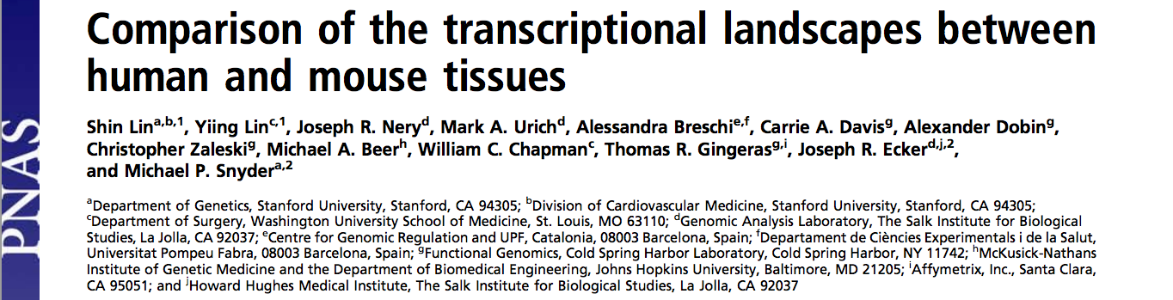
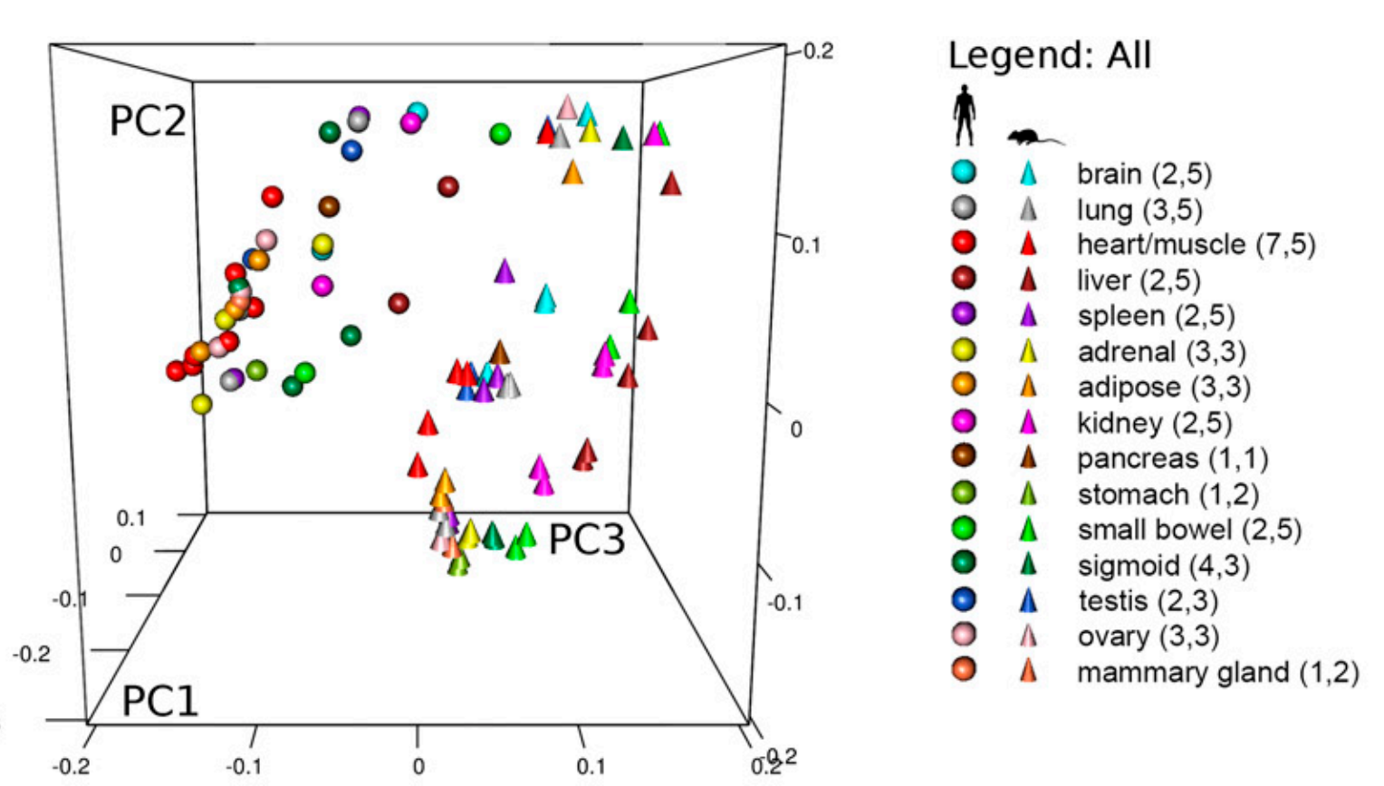
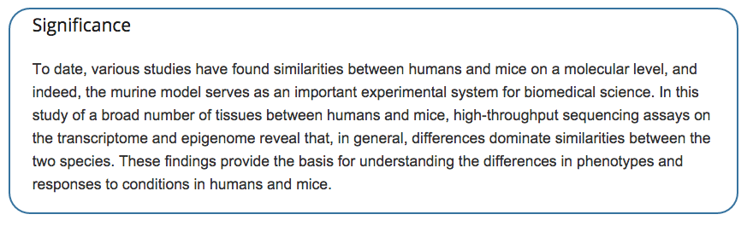

Slide 20

“The implications of the observation that human and mouse gene expression data may be clustering by species more than by tissues can be profound. To a large degree, modern biology is built upon the empirical observation that homologous gene regulatory networks establish the identities of homologous cell-types, tissues, and organs across species – the results of Lin et al., if true, challenge these observations and the biological basis of homology. From a more practical perspective, the mouse is arguably the most important animal model for biomedical research. If gene regulation in any mouse tissue is markedly more representative of a general mouse regulatory network than the regulatory network of a corresponding human tissue, this would call into question the utility of the mouse, and perhaps any other non-human animal, as a useful model system for biomedical research.”

Slide 21
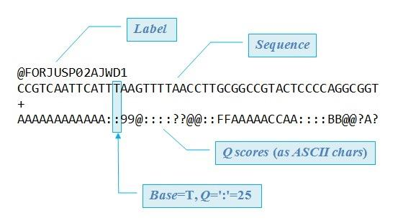
remember the structure of a .fastq file?

Slide 22
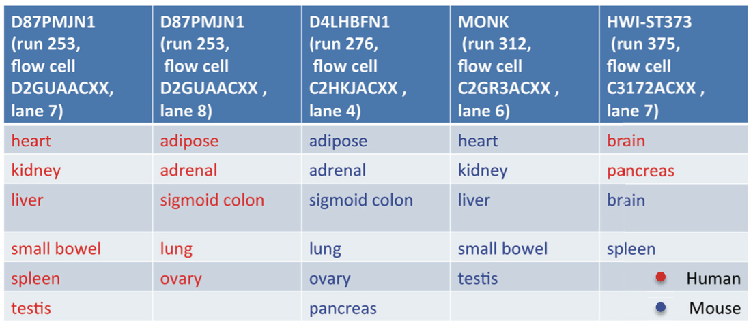
@<machine_id>:<runnumber>:<flowcellID>:<lane>:<tile>:<x-pos>: <y-pos> <read>:<is filtered>:<control number>:<index sequence>
@D4LHBFN1:276:C2HKJACXX:4:1101:3448:12374 1:N:0:AGTTCC
Machine ID
run#
Flowcell ID
Lane
Tile
Xpos
Ypos
Read
Is filtered?
control#
Barcode

Slide 23
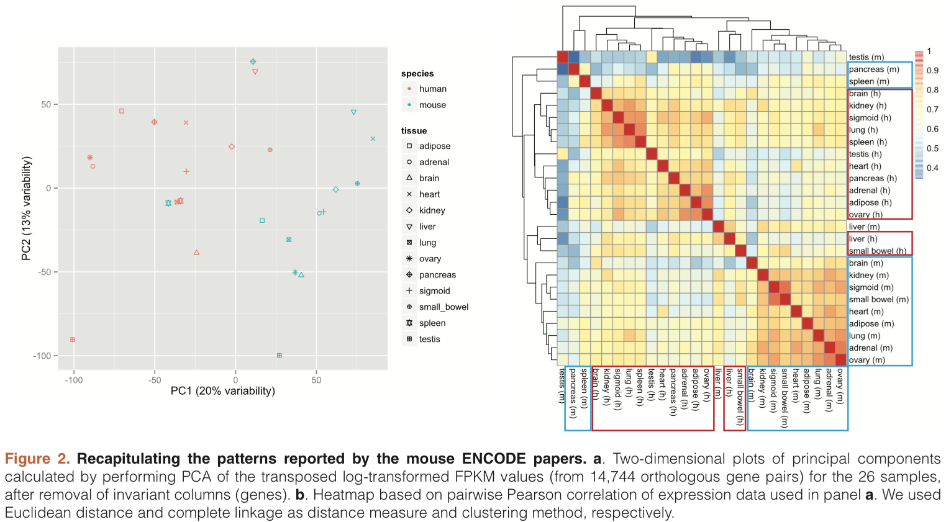

Slide 24
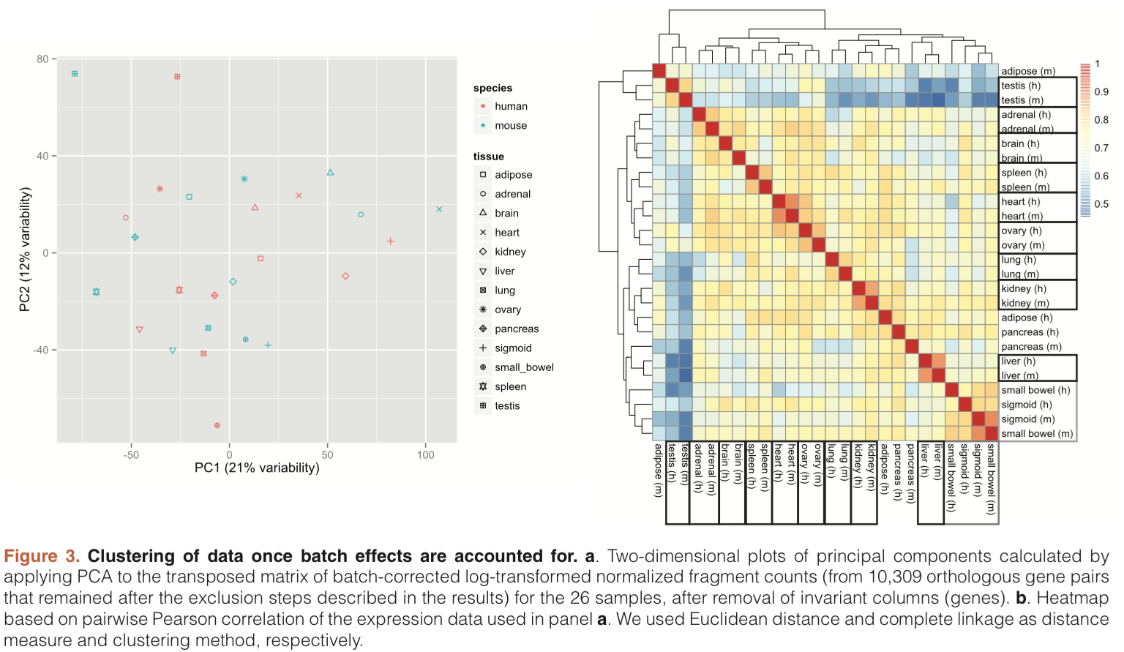

Slide 25



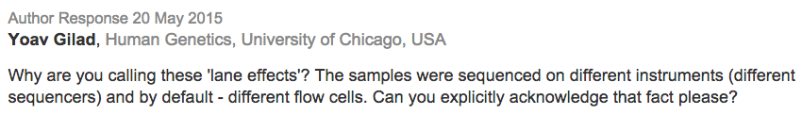
“There remains the issue of our study design with respect to confounding of lane effect and species. It should be noted that our study design minimized library preparation and primer index effect. Although our experience is consistent with [reports] showing that lane effect is not a large contributor to variance, we recognize it is better to have data. Thus, we are sequencing under a new pattern of pooled libraries, and soon, we will post the results for the community.” - authors of PNAS study

Slide 26

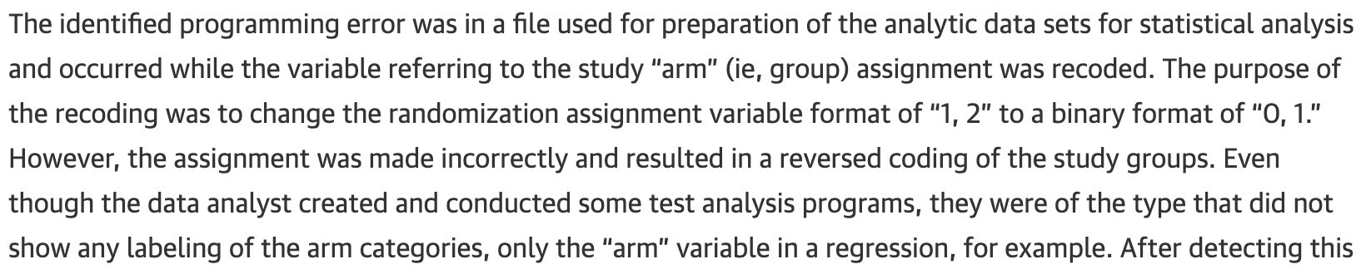

Slide 27
back to script

Slide 28
Data wrangling with the dplyr package
Four key ‘verbs’ of dplyr
Mutate - add new columns as a function of existing data
Filter - picks rows based on rules you apply
Select - picks columns based on rules you apply
Arrange - reorders rows by sorting based on column(s)

Slide 29
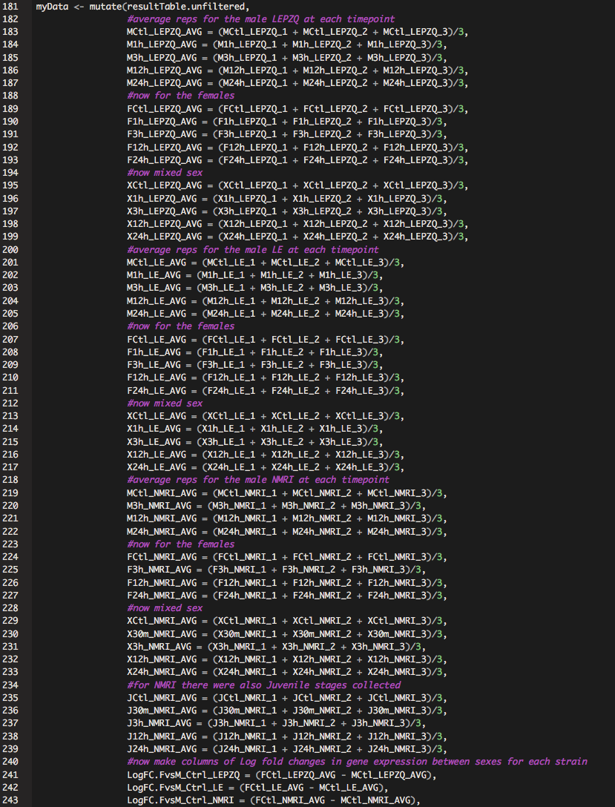
dplyr::mutate
for very large dataframes

Slide 30
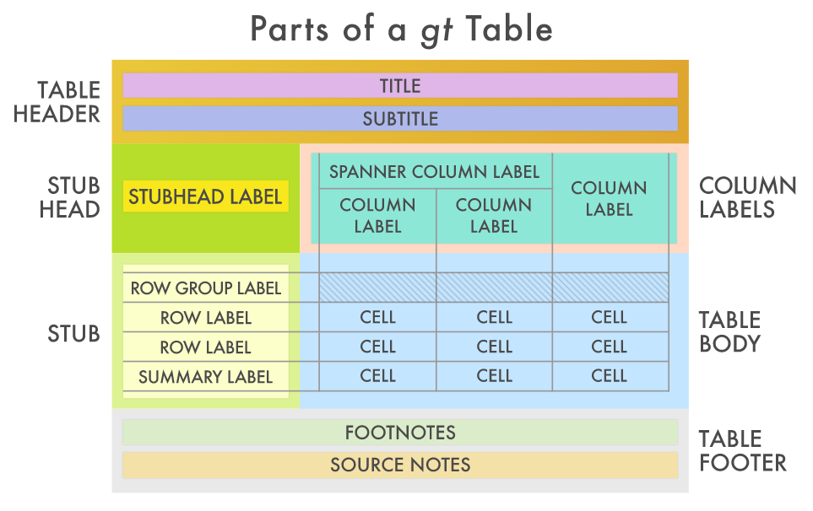
A grammar for making tables

